Slide 1
CHAPTER 9
Multivariate Correlational Research

Slide 2
Reviewing the Three Causal Criteria
Three criteria for establishing causation
  Covariance
  Temporal precedence
  Internal validity
Multivariate designs involve more than two measured variables.
  Longitudinal designs help address temporal precedence.
  Multiple regression analyses help address internal validity.
Notes:
Multivariate designs, such as longitudinal designs and multiple-regression designs, involve more than two measured variables. Multivariate designs will get us closer to causality than did bivariate designs.
Three criteria for causation
Covariance: Are the two variables related?
Temporal precedence: Does one variable cause the other variable?
Internal validity: Is there a third variable that might explain the relationship of the first two variables?

Slide 3
Interpreting Results from Longitudinal Designs
Cross-sectional correlations
Autocorrelations
Cross-lag correlations
Notes:
Longitudinal designs yield three types of correlations: cross-sectional correlations, autocorrelations, and cross-lag correlations. Let’s look at each type of correlation separately.

Slide 4
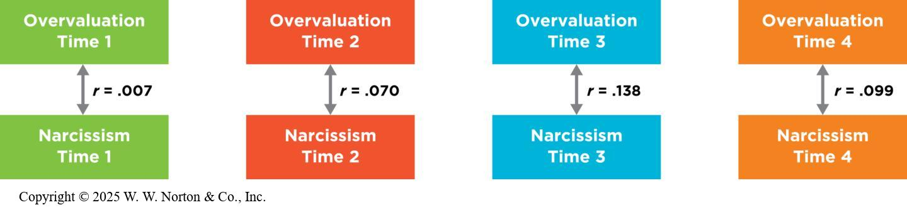
Cross-Sectional Correlations
Notes:
Parental overvaluation,
the tendency to view a child as superior, more deserving, and more special than others, is a key social catalyst for developing childhood narcissism.
Look at the correlations of the variables when measured at the same time. Within each time period, the mothers’ overvaluation is weakly associated with child narcissism. Notice that the arrows point in both directions because in these cross-sectional correlations, the two variables were measured at the same time, so we don’t know which came first. The figure shows zero-order (bivariate) correlations. (Source: Adapted from Brummelman et al., 2015.)
Cross-sectional correlations: Tests of whether two variables measured at the same point in time are correlated.
Example: This study reports that the correlation between mothers’ narcissism at Time 4 and children’s narcissism at Time 4 was r = .099. This is a weak correlation, but it is consistent with the hypothesis. However, because both variables in a cross-sectional correlation were measured at the same time, this result alone cannot establish temporal precedence as either one of these variables might have led to changes in the other.
Copyright © 2025 W. W. Norton & Co., Inc.

Slide 5
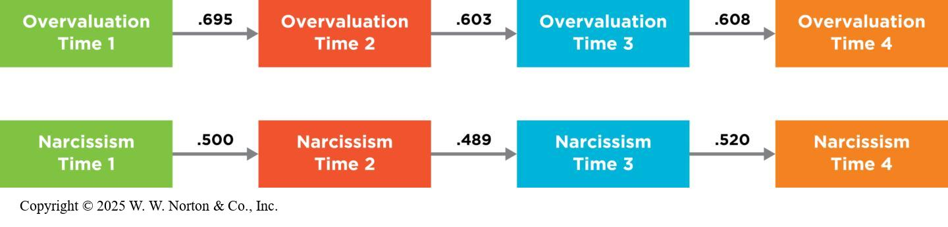
Autocorrelations
Notes:
Figure 9.2: Autocorrelations
In a longitudinal study, researchers also investigate the autocorrelations. These results indicate that both variables seem to be relatively stable over time. Notice that the arrows point in only one direction, because we are sure that the Time 1 measurements came before the Time 2 measurements. (Source: Adapted from Brummelman et al., 2015.)
Autocorrelations: The correlation of each variable with itself across time.
Example: The Brummelman team asked whether mothers’ overvaluation at Time 1 was associated with mothers’ overvaluation at Time 2, Time 3, and so on; they also asked whether children’s narcissism at Time 1 was associated with their narcissism scores at Time 2, Time 3, and so on.
Copyright © 2025 W. W. Norton & Co., Inc.

Slide 6
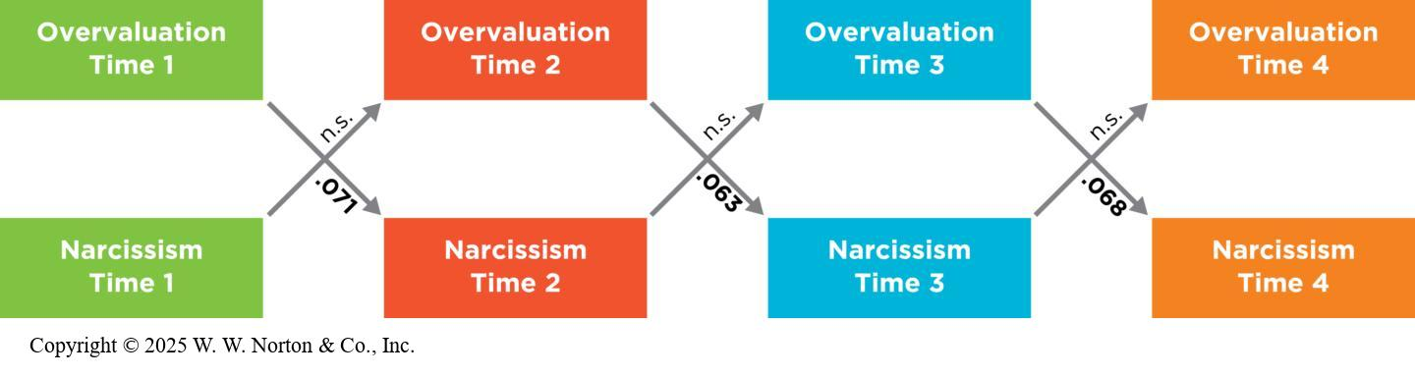
Cross-Lag Correlations
Notes:
Figure 9.3: Results of a Cross-Lag Study
The cross-lag correlations in this study are consistent with the conclusion that parental overpraise comes before narcissism because overpraise in early time periods significantly predicts later narcissism, but narcissism in earlier time periods was not significantly (n.s.) related to later overpraise. The arrows point in only one direction because in each case the method makes clear which variable came first in time; Time 1 always comes before Time 2, and so on. Values shown are associated with mothers’ overpraise. (Source: Adapted from Brummelman et al., 2015.)
Cross-lag correlations: Correlations of the degree to which an earlier measure of one variable is associated with a later measure of the other variable; examines how people change over time. Researchers are most interested in cross-lag correlations because they help establish temporal precedence.
Example: In the Brummelman study, the cross-lag correlations show how strongly mothers’ overvaluation at Time 1 is correlated with child narcissism later on, compared to how strongly child narcissism at Time 1 is correlated with mothers’ overvaluation later on.
Note that Brummelman simply uses the abbreviation “n.s.” meaning “not significant,” instead of reporting the actual 95% CI for nonsignificant correlations. The CIs for these nonsignificant correlations would include 0 in their interval, for example [-.09, .07]. The inclusion of 0 is what allows us to call these statistically insignificant.
Three possible patterns from a cross-lag study:
The study did show that parental overpraise (overvaluation) at earlier time periods was significantly correlated with child narcissism at the later time periods. Such a pattern was consistent with the argument that overpraise leads to increases in narcissism over time.
The study could have shown the opposite result: that narcissism at earlier time periods was significantly correlated with overpraise later. Such a pattern would have indicated that the childhood narcissistic tendency came first, leading parents to change their type of praise later.
The study could have shown that both correlations are significant—that overpraise at Time 1 predicted narcissism at Time 2 and that narcissism at Time 1 predicted overpraise at Time 2. If that had been the result, it would mean excessive praise and narcissistic tendencies are mutually reinforcing.
Copyright © 2025 W. W. Norton & Co., Inc.

Slide 7

Longitudinal Studies and the Three Criteria for Causation
Longitudinal designs can provide some evidence for causation by fulfilling three criteria
  Covariance
  Temporal precedence
  Internal validity
Notes:
Figure 9.4: Praising Children
Correlational and experimental studies suggest that when adults praise children’s learning strategies and efforts (compared with praising the type of person they are), kids respond favorably and continue to work hard.
Longitudinal designs can provide some evidence for causation by fulfilling these three criteria:
Covariance: When the cross-sectional correlations are significant, covariance has been established.
Temporal precedence: If one of the cross-lag correlations is stronger than the other, it moves us closer to figuring out which variables causes the other.
Internal validity: By measuring only four variables, as we have in the TV and aggression example, longitudinal designs do not rule out third-variable explanations. Researchers might be able to design their studies in particular ways or do subsequent statistical analyses to address some third variables.
asiseeit/Getty Images

Slide 8
Why Not Just Do an Experiment?
In many cases participants cannot be randomly assigned to a variable.
  People cannot be assigned to preferences.
  It may be unethical to assign participants.
Notes:
Examples:
Researchers cannot manipulate personality traits, such as narcissism in children.
Parents can’t easily be assigned to daily parenting styles.
It could be unethical to assign some people, especially children, to a condition in which they receive a certain type of praise, especially over a long time period, and particularly if we suspect that this type of praise might make children narcissistic or encourage some other bad outcome.

Slide 9
Ruling Out Third Variables with Multiple-Regression Analyses
Regression modeling!
Can be used to potentially rule out third variables
Notes:
These are the section headings.
Note: The Active Learning slides at the end of this presentation show Beth Morling’s own lecture notes for teaching regression.
Multiple regression (also known as multivariate regression): helps address questions of internal validity by ruling out some third variables.

Slide 10
Linear Regression
Regression Basics:
  Assumption: linear relationship between test scores and criterion scores.
  Formula for straight line: y = bx + e
Predicting?
  Take the test scores (x), plug into the formula, and generate a y score for each individual.
  Does mean y differ between groups?
Notes:
Assumption of regression analysis: There is a linear relationship between test scores and criterion scores.
Formula for straight line:
Ĉ = a + b(T) where:
Ĉ is the predicted training criterion score for an individual training candidate,
a is the intercept,
b is the regression coefficient or slope, and
T is an individual’s aptitude test score.
This formula can be used to predict criterion scores from test scores.
Use of software packages: We can use software packages such as SPSS and SAS to conduct the regression analysis, which produces values of a and b.
Evaluating predictive ability of the test: This is done by taking any individual’s score on the test (T), plugging it into the regression equation, and calculating a predicted score on the criterion (Ĉ) for that individual.

Slide 11
b₀
b₀ is the intercept (y intercept)
The intercept is the value of the Y variable when all Xs = 0.
This is the point at which the model plane crosses the Y-axis (vertical).

Slide 12
Beta Values
b₁ is the coefficient for variable 1 (x)
You can have linear models with many predicters
  b₂ is the coefficient for variable 2.
  b_{n} is the coefficient for n^{th} variable.

Slide 13
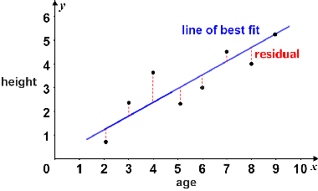
Fit Lines

Slide 14
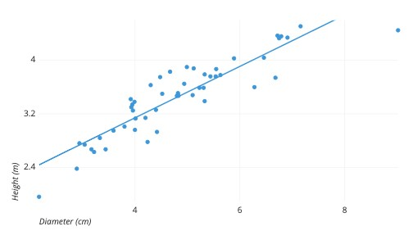
Simple Linear Regression
Formula: y = bx + e
Notes:
Least squares methods

Slide 15
Why use regression?
Predicting outcomes: Which variables are most likely to influence an individual’s scores
  Does mean y differ between groups?
  Are some variables better predictors for some groups than others?
  Particularly helpful when multiple variables are being compared

Slide 16
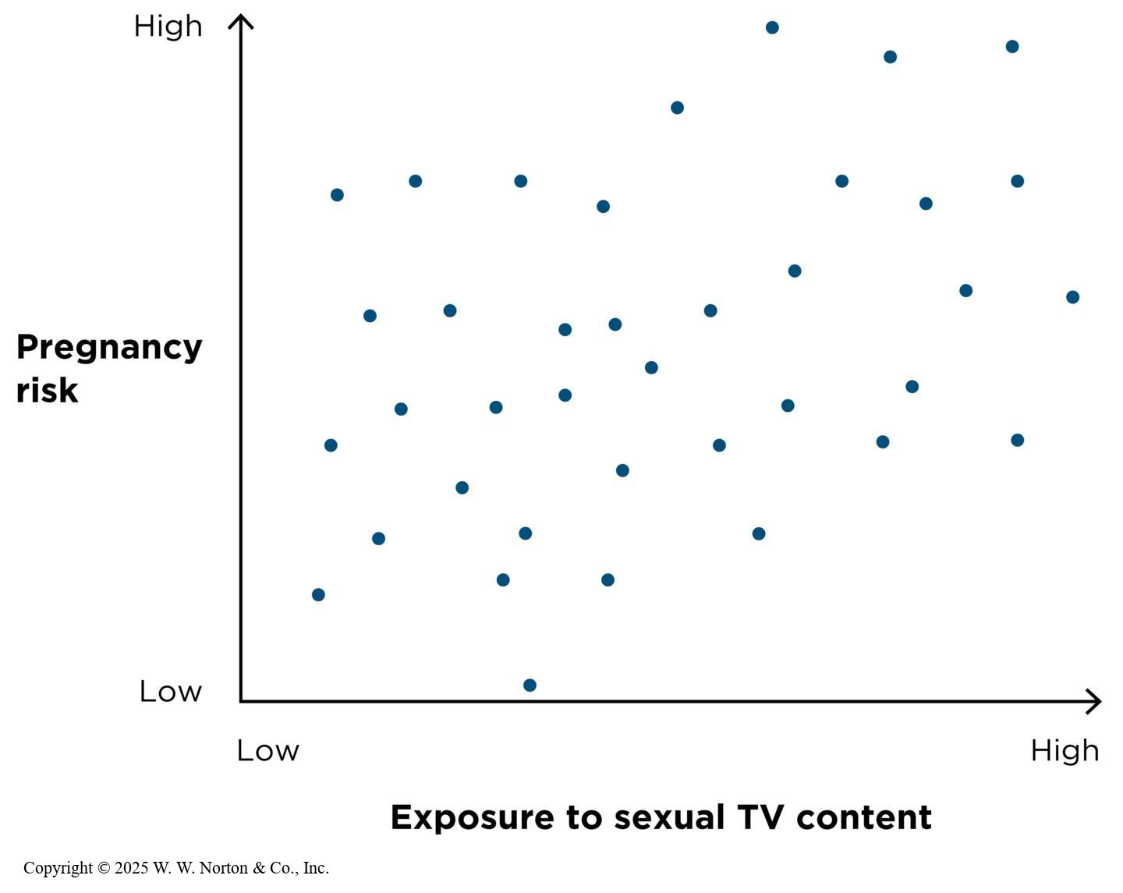
Example: Pregnancy Risk and TV Content
Notes:
Figure 9.5: Correlating Sexual TV Content with Pregnancy Risk
Higher rates of sexual content on TV go with higher risk of pregnancy, and lower rates of sexual content go with lower risk of pregnancy. (Data are fabricated for illustration purposes.)
In a bivariate correlational study of sexual TV content and pregnancy risk, the two variables were positively correlated such that higher amounts of sex on TV were associated with a higher risk of pregnancy. But the researchers also measured several other variables (e.g., the total amount of time teenage participants watched any kind of TV, their age, their academic grades, and whether they lived with both parents). Thus, the researchers were able to conduct a multivariate correlational study.
Copyright © 2025 W. W. Norton & Co., Inc.

Slide 17
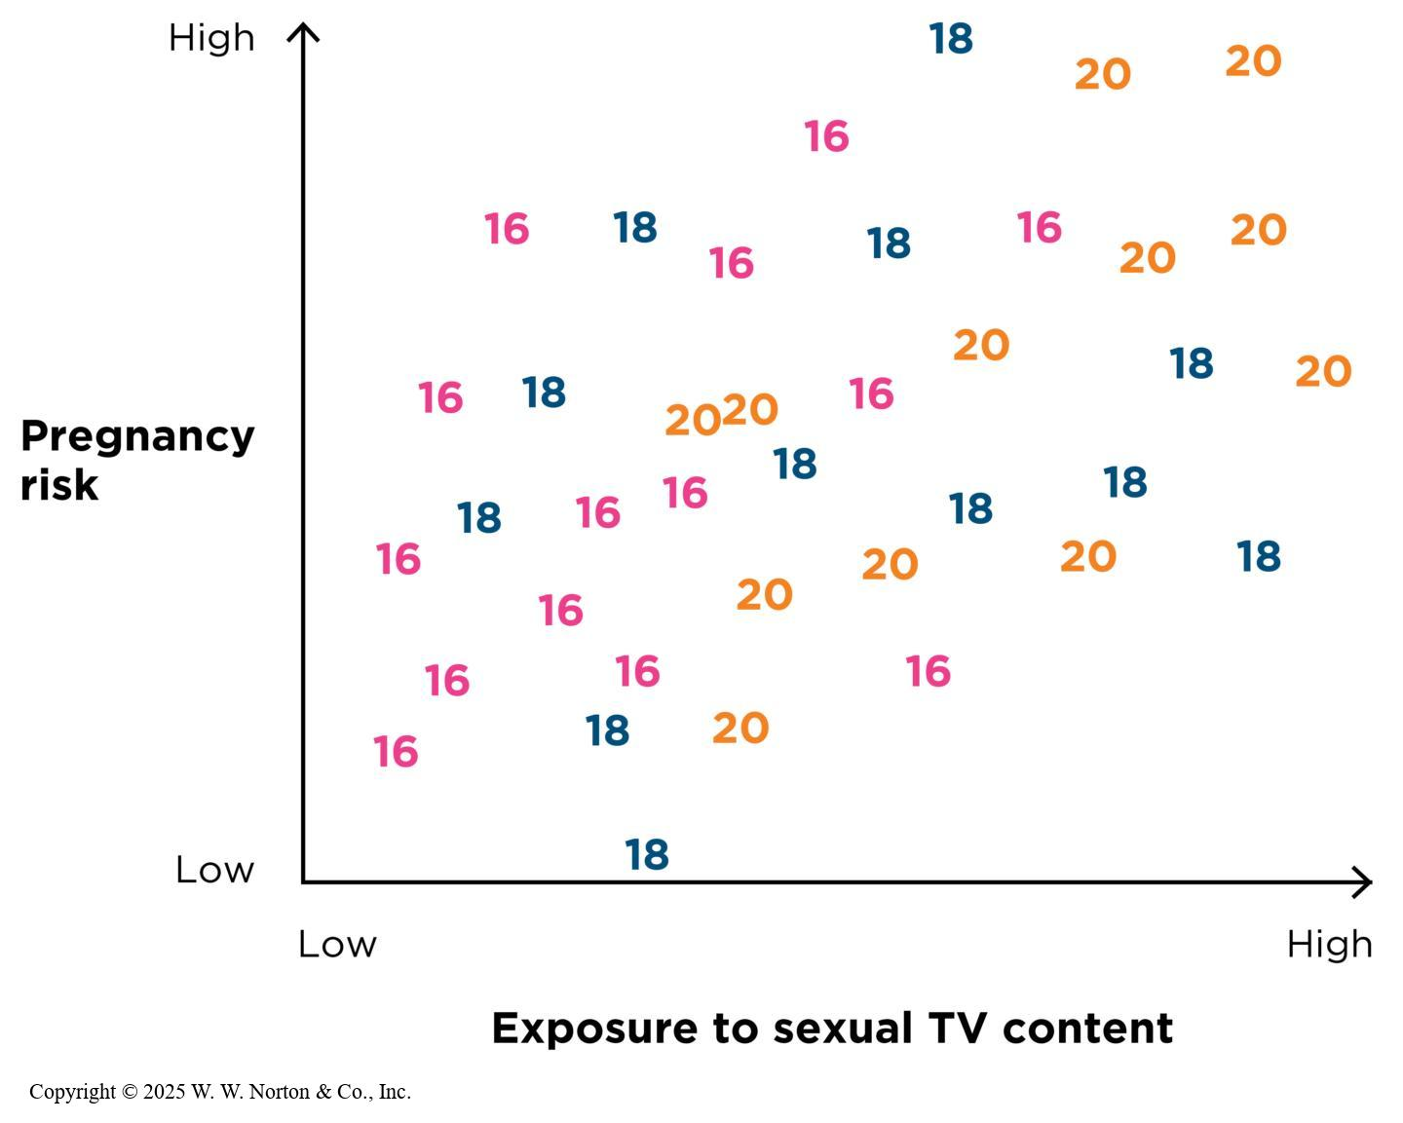
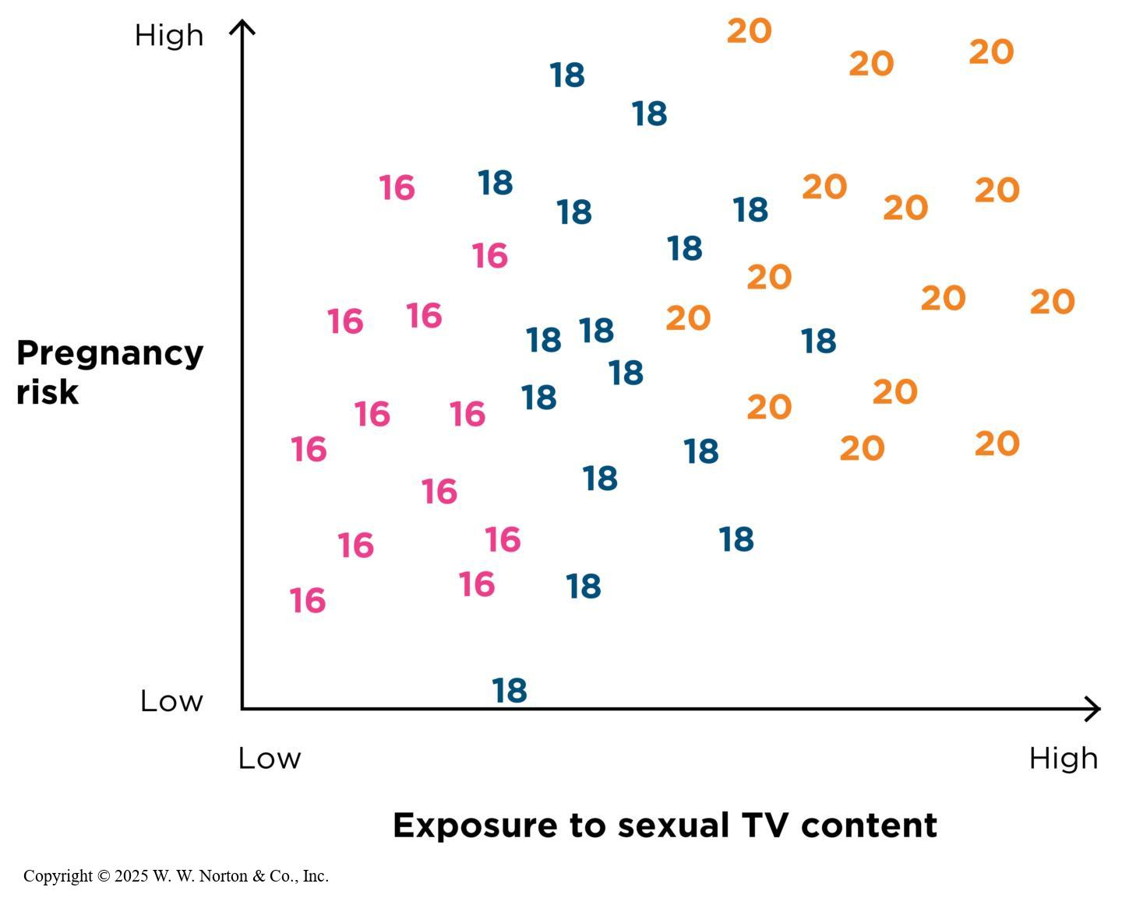
Using Statistics to Control for Third Variables
Two possible outcomes when controlling for age:
Notes:
Figure 9.6: The Association Between Sexual TV Content and Pregnancy Remains Positive, Even Controlling for Age
The overall relationship shown here is positive, and this holds even within the three subgroups: age 20, age 18, and age 16. (Data are fabricated for illustration purposes.)
Copyright © 2025 W. W. Norton & Co., Inc.
Figure 9.7: The Association Between Sexual TV Content and Pregnancy Goes Away, Controlling for Age
The overall association shown here is positive, but if we separately consider the subgroups of age 20, age 18, or age 16, there is no relationship between the two variables. (Data are fabricated for illustration purposes.)
To control for means to hold constant. When conducting a multivariate design, the relationship between two variables still exists when controlling for another variable. Perhaps sexual content and pregnancy are correlated only because older teens are both more likely to watch more mature shows and more likely to be sexually active. If this is the case, all three variables are correlated with one another: Viewing sex on TV and getting pregnant are correlated, as we already determined, but sex on TV and age are also correlated with each other, and age and pregnancy are correlated too. The researchers want to know whether age, as a third variable correlated with both the original variables, can account for the relationship between sexual TV content and pregnancy rates. To answer the question, they see what happens when they control for age.
We can think of controlling for in terms of proportions of variability. After the relationship between pregnancy risk and age is take taken into account, is there still a proportion of variability in behavior that’s attributable to exposure to sexual content?
One possible outcome is shown in Figure 9.5, and a different outcome is shown in Figure 9.6.
In Figure 9.5, the overall relationship shown here is positive, even within the three subgroups: age 20, age 18, and age 16.
In Figure 9.6, the overall association is positive, but if we consider the subgroups of age 20, age 18, and age 16 separately, there is no relationship between the two variables.
Copyright © 2025 W. W. Norton & Co., Inc.

Slide 18
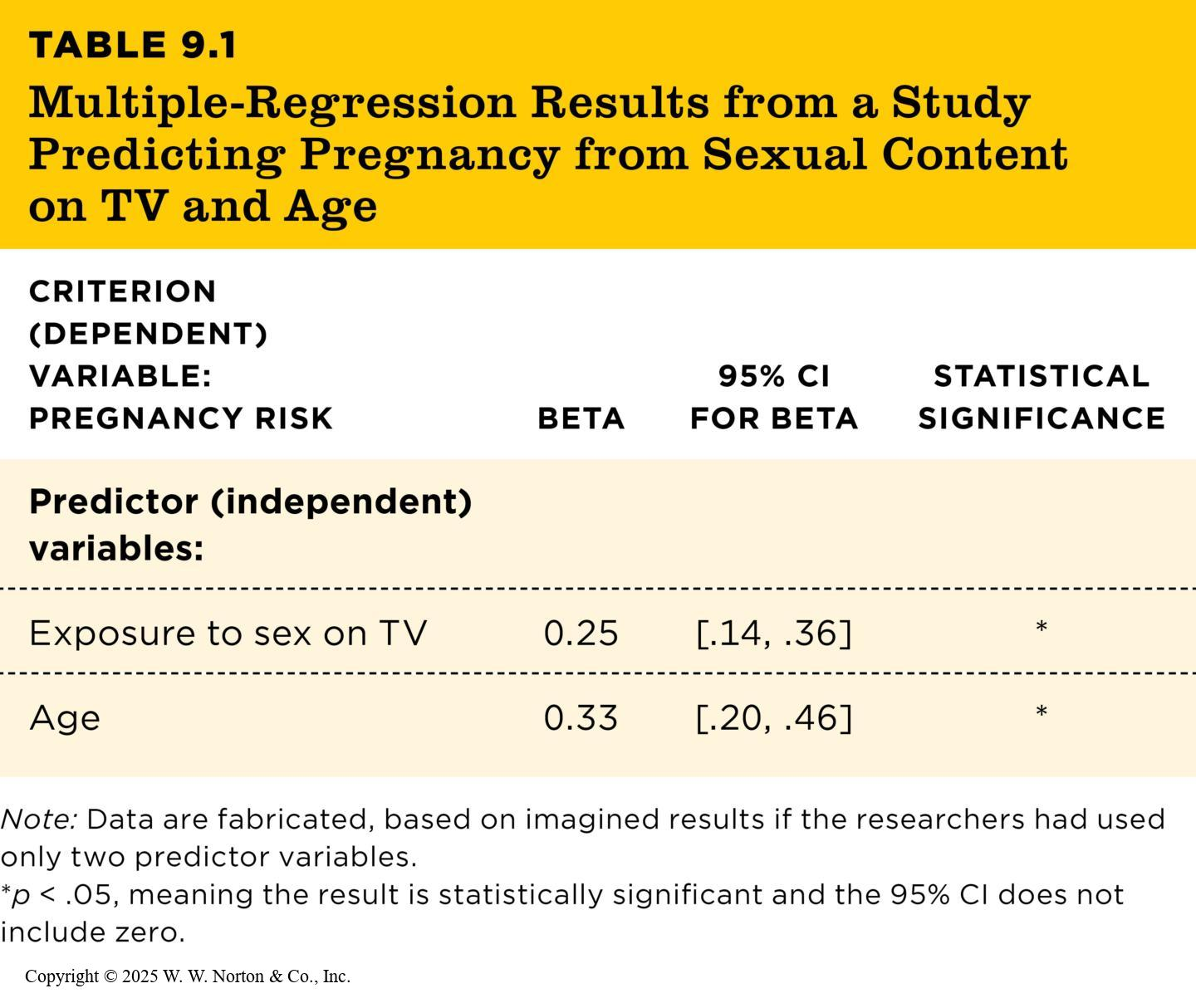
Using Beta to Test for Third Variables (1 of 3)
Beta basics
Interpreting beta
TABLE 9.1
TABLE 9.1 Multiple-Regression Results from a Study Predicting Pregnancy from Sexual Content on TV and Age
CRITERION (DEPENDENT) VARIABLE: PREGNANCY RISK | BETA | 95% CI FOR BETA | STATISTICAL SIGNIFICANCE
Predictor (independent) variables:
Exposure to sex on TV | 0.25 | [.14, .36] | *
Age | 0.33 | [.20, .46] | *
Note: Data are fabricated, based on imagined results if the researchers had used only two predictor variables.
*p < .05, meaning the result is statistically significant and the 95% CI does not include zero.
Notes:
Table 9.1: Multiple-Regression Results from a Study Predicting Pregnancy from Sexual Content on TV and Age
Beta basics: If you look at the table, you will see a column labeled “beta,” and there will be a beta value for each predictor variable. Beta is similar to r. A positive beta indicates a positive relationship between that predictor variable and the criterion variable when the other predictors are statistically controlled for. A negative beta reflects a negative relationship when other predictors are controlled for. A beta that is zero or not significantly different from zero suggests that there is no relationship when other predictors are controlled for.
Similarities between beta and r: direction (positive or negative) and strength (the closer to -1 or +1, the stronger the relationship; the closer to zero, the weaker the relationship). You may compare beta strengths within a single regression table, but you may not compare beta strengths across regression tables. There are no absolute cutoffs for beta effect sizes as we have with r and Cohen’s cutoffs. Sometimes a regression table will report b instead of beta; b is an understandardized coefficient. You cannot compare two b values in the same table.
Interpreting beta: Exposure to sex on TV has a beta of 0.25. This positive beta, like a positive r, means higher levels of sex on TV go with higher pregnancy risk (and lower levels of sex on TV go with lower pregnancy risk), even when we statistically control for the other predictor on this table—age. The other beta, associated with the age predictor variable, is also positive. This beta means that older age is associated with higher pregnancy rates, when exposure to sex on TV is controlled for.

Slide 19
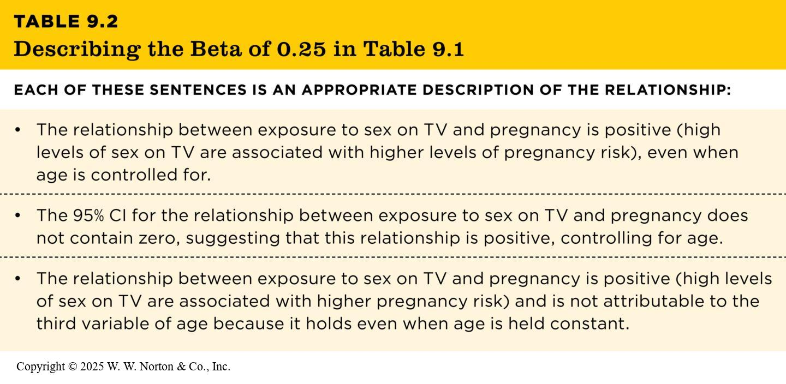
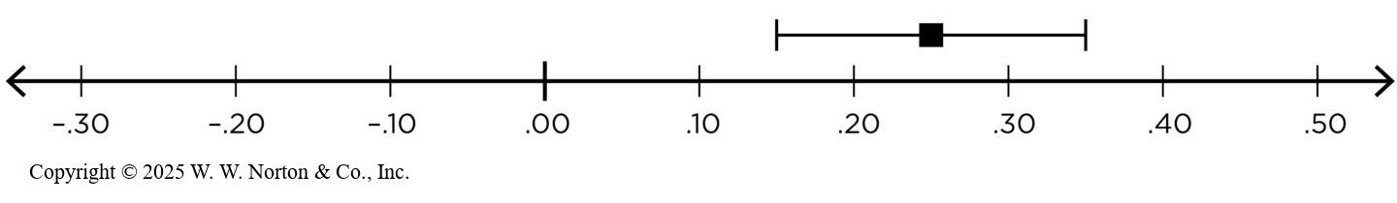
Using Beta to Test for Third Variables (2 of 3)
95% CIs and statistical significance of beta
TABLE 9.2
TABLE 9.2 Describing the Beta of 0.25 in Table 9.1
EACH OF THESE SENTENCES IS AN APPROPRIATE DESCRIPTION OF THE RELATIONSHIP:
• The relationship between exposure to sex on TV and pregnancy is positive (high levels of sex on TV are associated with higher levels of pregnancy risk), even when age is controlled for.
• The 95% CI for the relationship between exposure to sex on TV and pregnancy does not contain zero, suggesting that this relationship is positive, controlling for age.
• The relationship between exposure to sex on TV and pregnancy is positive (high levels of sex on TV are associated with higher pregnancy risk) and is not attributable to the third variable of age because it holds even when age is held constant.
Notes:
Table 9.2: Describing the Beta of 0.25 in Table 9.1
Copyright © 2025 W. W. Norton & Co., Inc.
Figure 9.8: Confidence intervals and Statistical Significance of Beta
When the 95% CI does not include zero, we can say the beta is “statistically significant.”
Statistical significance of beta: In a regression table, especially a more recent one, there is a column labeled 95% CI, which presents the confidence interval for each beta. Regression tables published earlier may only have a column labeled p or sig or an asterisk footnote with p values. A p value .05 compliments the .95 from a 95% CI, so a p value of less than .05 means that the associated CI does not include zero, and the beta is statistically significant. When p is greater than .05, the associated CI does include zero and the beta is not significant (see Figure 9.8). As you know from Table 9.1, both the betas are significant. Table 9.2 shows a number of ways to explain what the significant betas mean.
Copyright © 2025 W. W. Norton & Co., Inc.

Slide 20
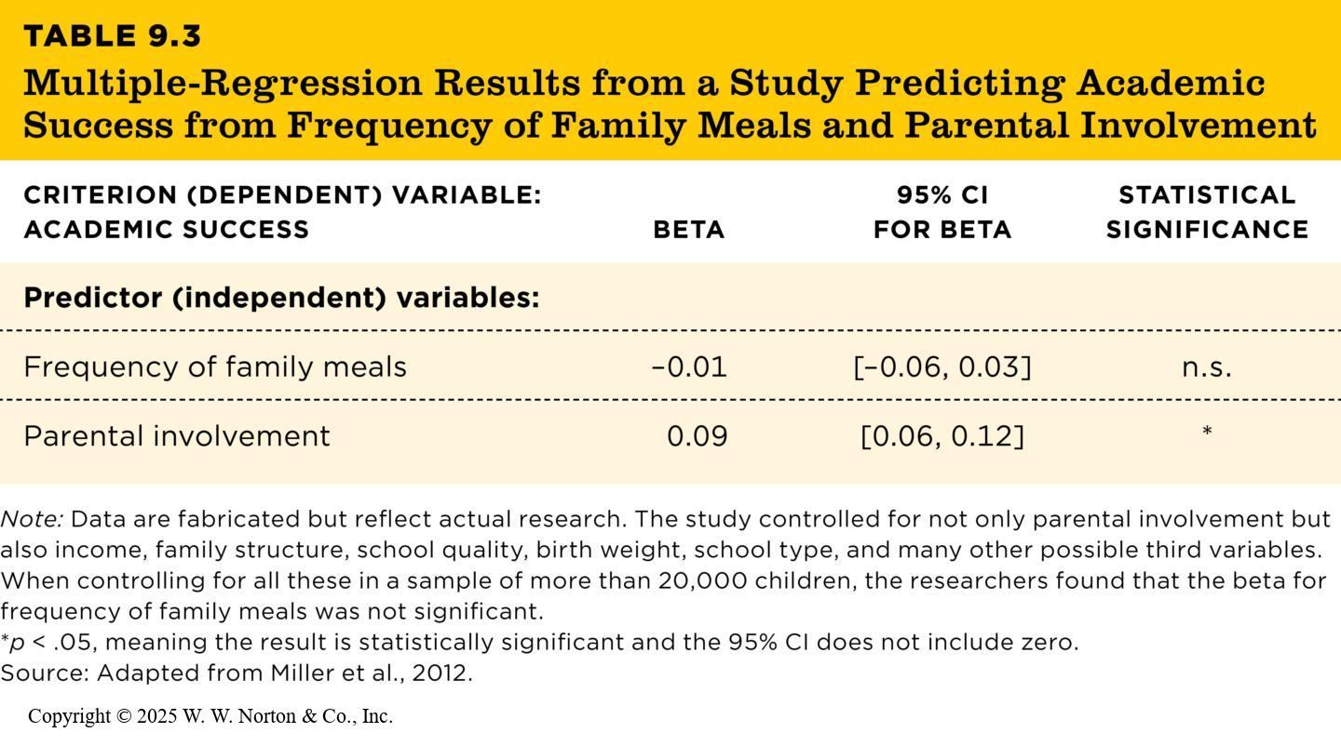
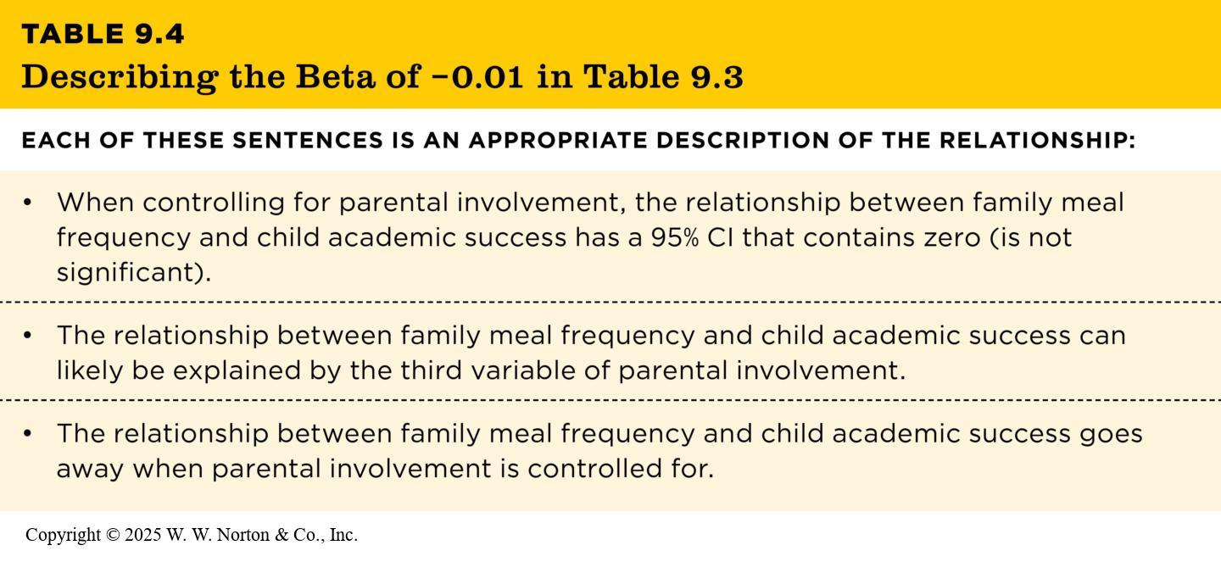
Using Beta to Test for Third Variables (3 of 3)
What if beta is close to zero?
TABLE 9.3
TABLE 9.4
TABLE 9.3 Multiple-Regression Results from a Study Predicting Academic Success from Frequency of Family Meals and Parental Involvement
CRITERION (DEPENDENT) VARIABLE: ACADEMIC SUCCESS | BETA | 95% CI FOR BETA | STATISTICAL SIGNIFICANCE
Predictor (independent) variables:
Frequency of family meals | –0.01 | [–0.06, 0.03] | n.s.
Parental involvement | 0.09 | [0.06, 0.12] | *
Note: Data are fabricated but reflect actual research. The study controlled for not only parental involvement but also income, family structure, school quality, birth weight, school type, and many other possible third variables. When controlling for all these in a sample of more than 20,000 children, the researchers found that the beta for frequency of family meals was not significant.
*p < .05, meaning the result is statistically significant and the 95% CI does not include zero.
Source: Adapted from Miller et al., 2012.
TABLE 9.4 Describing the Beta of −0.01 in Table 9.3
EACH OF THESE SENTENCES IS AN APPROPRIATE DESCRIPTION OF THE RELATIONSHIP:
• When controlling for parental involvement, the relationship between family meal frequency and child academic success has a 95% CI that contains zero (is not significant).
• The relationship between family meal frequency and child academic success can likely be explained by the third variable of parental involvement.
• The relationship between family meal frequency and child academic success goes away when parental involvement is controlled for.
Notes:
Table 9.3: Multiple-Regression Results from a Study Predicting Academic Success from Frequency of Family Meals and Parental Involvement
Copyright © 2025 W. W. Norton & Co., Inc.
Table 9.4: Describing the Beta of −0.01 in Table 9.3
Statistical significance of beta: In a regression table, especially a more recent one, there is a column labeled 95% CI, which presents the confidence interval for each beta. (Regression tables published earlier may only have a column labeled p or sig or an asterisk footnote with p values.) A p value of .05 compliments the .95 from a 95% CI, so a p value of less than .05 means that the associated CI does not include zero, and the beta is statistically significant. When p is greater than .05, the associated CI does include zero and the beta is not significant. As you know from Table 9.3, both the betas are nonsignificant. Table 9.4 shows a number of ways to explain what the nonsignificant betas mean.
Copyright © 2025 W. W. Norton & Co., Inc.

Slide 21
Regression Results Indicate Whether a Third Variable Explains the Relationship
Criterion variables and predictor variables
Using beta to test for third variables
TABLE 9.1
TABLE 9.1 Multiple-Regression Results from a Study Predicting Pregnancy from Sexual Content on TV and Age
CRITERION (DEPENDENT) VARIABLE: PREGNANCY RISK | BETA | 95% CI FOR BETA | STATISTICAL SIGNIFICANCE
Predictor (independent) variables:
Exposure to sex on TV | 0.25 | [.14, .36] | *
Age | 0.33 | [.20, .46] | *
Note: Data are fabricated, based on imagined results if the researchers had used only two predictor variables.
*p < .05, meaning the result is statistically significant and the 95% CI does not include zero.
Notes:
Table 9.1: Multiple-Regression Results from a Study Predicting Pregnancy from Sexual Content on TV and Age
We can use the statistical technique of multiple regression to tell us which of the two scatterplots on the previous slide, Figure 9.6 or Figure 9.7, best describes the relationship between pregnancy and sexual TV content. Regression tests whether a key relationship still exists when a third variable is statistically controlled for. This is a regression table such as you might see in a journal article.
Copyright © 2025 W. W. Norton & Co., Inc.

Slide 22
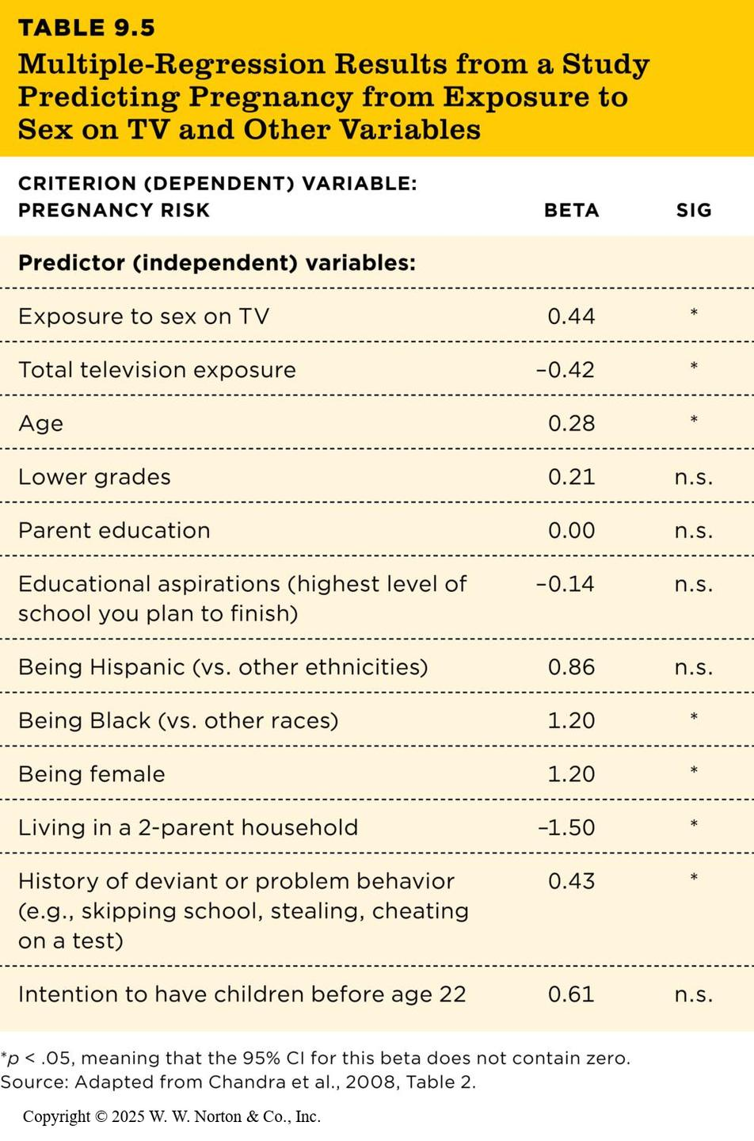
Adding More Predictors to a Regression
TABLE 9.5
TABLE 9.5 Multiple-Regression Results from a Study Predicting Pregnancy from Exposure to Sex on TV and Other Variables
CRITERION (DEPENDENT) VARIABLE: PREGNANCY RISK | BETA | SIG
Predictor (independent) variables:
Exposure to sex on TV | 0.44 | *
Total television exposure | –0.42 | *
Age | 0.28 | *
Lower grades | 0.21 | n.s.
Parent education | 0.00 | n.s.
Educational aspirations (highest level of school you plan to finish) | –0.14 | n.s.
Being Hispanic (vs. other ethnicities) | 0.86 | n.s.
Being Black (vs. other races) | 1.20 | *
Being female | 1.20 | *
Living in a 2-parent household | –1.50 | *
History of deviant or problem behavior (e.g., skipping school, stealing, cheating on a test) | 0.43 | *
Intention to have children before age 22 | 0.61 | n.s.
*p < .05, meaning that the 95% CI for this beta does not contain zero.
Source: Adapted from Chandra et al., 2008, Table 2.
Notes:
Table 9.5: Multiple-Regression Results from a Study Predicting Pregnancy from Exposure to Sex on TV and Other Variables
Thus far, in our pregnancy risk and exposure to sexual TV content example, we have only examined one possible third variable: age.
But there may be other potential third variables (see Table 9.5). Regression analysis can help answer two questions: (1) it helps control for several third variables at once and (2) it examines the betas for all the other predictor variables to get a sense of which factors most strongly predict chance of pregnancy. One strong predictor is gender, which, as you can see, has a beta of 1.20, even when the other variables are controlled for.
Copyright © 2025 W. W. Norton & Co., Inc.

Slide 23
Using Regression to Test for Response Bias:
Are some variables better predictors for some groups than others?
Do tests/measures produce different results for different groups?

Slide 24

Testing for Bias (1)
Intercept Bias
Where does line cross y axis?
Different baselines
Notes:
Figure 11.8: Regression lines for males and females in relation to the common regression line illustrating possible intercept bias.
If a test suffers only from intercept bias, then the size of the group discrepancy is constant across all aptitude scores.
This figure shows that a male trainee of a given aptitude level will obtain a predicted rating that is always 4 points higher than a female who has the same level of aptitude.

Slide 25

Testing for Bias (2)
Slope Bias
Changes occur at different rates
Notes:
Figure 11.9: Regression lines for males and females in relation to the common regression line illustrating possible slope bias.

Slide 26

Testing for Bias (3)
Intercept and Slope Bias
Changes occur at different rates
AND
Groups have different baselines
Notes:
Figure 11.10: Regression lines for males and females in relation to the common regression line illustrating possible slope and intercept bias.
Intercept and slope bias: Occurs when there is a complex relationship between the test scores and the outcome scores for the different groups.

Slide 27

Regression Does Not Establish Causation
Multiple regression is not a foolproof way to rule out all kinds of third variables.
Notes:
Figure 9.10: Possible Third Variables in the Association Between Sexual TV Content and Pregnancy
What additional third variables, not already measured by the researchers, might be associated with both watching sex on TV and getting pregnant?
Multiple regression is not a foolproof way to rule out all kinds of third variables. Even if a researcher controls for a large number of variables, as the researchers did in the recess and behavior study, they couldn’t have controlled for everything.
There are two problems with making a causal statement such as “More exposure to sexual TV content causes higher risks of pregnancy.” (1) Multiple regression can control third variables but can’t establish temporal precedence. We don’t know which came first: viewing of sexual content or sexual activity. (2) Researchers can’t control for variables that they don’t measure, and there could be important third variables that they failed to measure.
Phovoir/Shutterstock

Slide 28

Getting at Causality with Pattern and Parsimony
The longer a person has smoked cigarettes, the greater are the chances of getting cancer.
People who stop smoking have lower cancer rates than people who continue smoking.
Smokers’ cancers tend to be in the lungs and of a particular type.
Smokers who use filtered cigarettes have a somewhat lower rate of cancer than smokers of unfiltered cigarettes.
People who live with smokers will also have higher rates of cancer because of their passive exposure to the same chemicals.
Notes:
Figure 9.11: Pattern and Parsimony
Many studies, using a variety of methods, provide converging evidence to support the causal claim that cigarettes contain toxic chemicals that harm humans. Although each of the individual studies has methodological weaknesses, taken together, they all support the same parsimonious conclusion.
We have already discussed how longitudinal designs can help with establishing temporal precedence and multiple-regression analyses can be used to help with internal validity by controlling for some potential third variables. But there’s another way that researchers can investigate causality, called “pattern and parsimony,” which examines a variety of correlational studies that all point in the same causal direction.
Parsimony: Simplicity; the degree to which a good scientific theory provides the simplest explanation of some phenomenon.
pixelrain/Shutterstock

Slide 29
Pattern, Parsimony, and the Popular Media
Journalists do not always fairly represent pattern and parsimony.
When journalists report only one study at a time, they are selectively presenting only part of the scientific process.
Notes:
Journalists tend to report only the results from the latest studies instead of providing a comprehensive review of the studies conducted in that area.
Science is cumulative, so if journalists are only reporting one study at a time, then they are selectively representing that area of research. Context is important here. Journalists should summarize an entire body of evidence as well as discussing theory when making a claim.

Slide 30
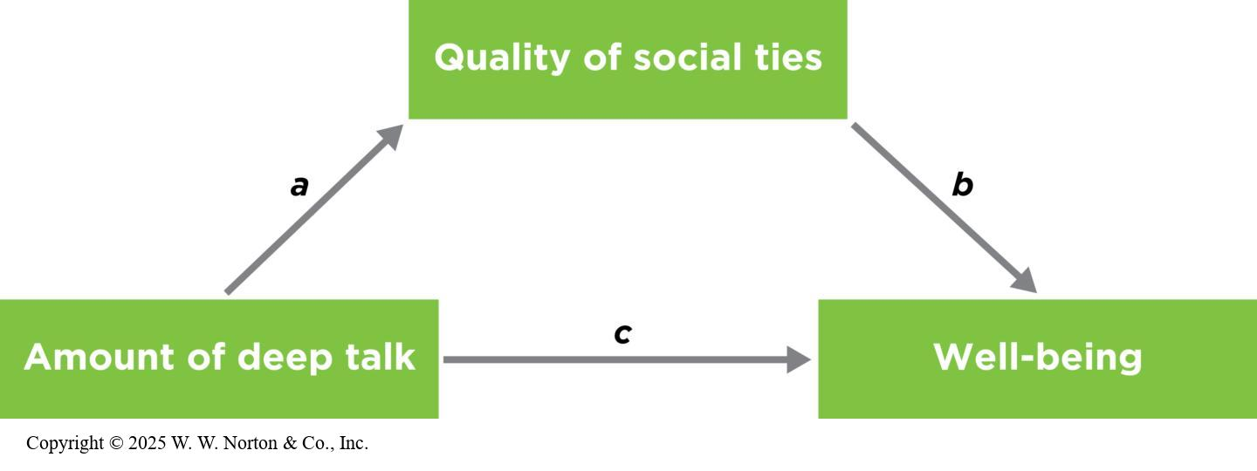
Mediation
Mediators versus third variables
  Mediators ask “why,” and moderators ask “for whom” or “when.”
Notes:
Figure 9.12: A Proposed Mediation Model
We could propose that deep talk leads to stronger social ties, which lead to increased wellbeing. Researchers use statistics to estimate how well their data fit this model.
Once a relationship between two variables has been established, we often want to explore it further by thinking about the reasons why. Consider this example: We know conscientious people are more physically healthy than less conscientious people. But why is that the case?
The mediator of this relationship might be the fact that conscientious people are more likely to follow medical advice and instructions, and that’s why they’re healthier. Similarly, we know there’s an association between having deep conversations and feelings of well-being (see Chapter 8). Researchers might next propose a reason—a mediator of this relationship.
One likely mediator could be social ties: Deeper conversations might help build social connections, which in turn can lead to increased well-being. The researchers could draw this mediation hypothesis, as shown in Figure 9.12. They would propose an overall relationship, c, between deep talk and well-being. However, this overall relationship exists only because there are two other relationships: a (between deep talk and social ties) and b (between social ties and well-being). In other words, social ties mediate the relationship between deep talk and well-being. (Of course, there are other possible mediators, such as intellectual growth or taking a break from technology. Those mediators could be tested too, in another study.)
Because mediation hypotheses are causal claims, mediation is definitively established only in conjunction with temporal precedence. The proposed causal variable is measured or manipulated first, followed by the mediating variable, followed by the proposed outcome variable (Maxwell & Cole, 2007). To establish mediation in the previous example, the researchers must conduct a study first measuring the amount of deep talk, followed shortly afterward by a measure of social tie strength. They would have to measure well-being last of all, to rule out the possibility that the well-being led to having deeper conversations.
Copyright © 2025 W. W. Norton & Co., Inc.

Slide 31
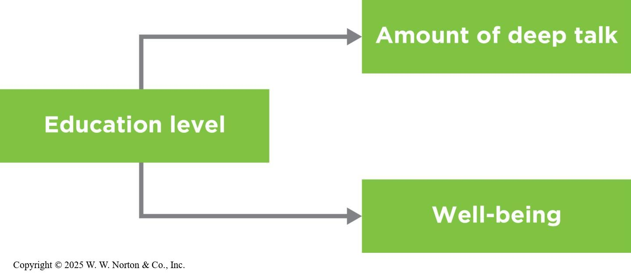
Mediators versus Third Variables
Similarities
  Both involve multivariate research designs.
  Both can be detected using multiple regression.
Differences
  Third variables are external to the bivariate correlation (problematic).
  Mediators are internal to the causal variable (not problematic).
Notes:
Figure 9.13: A Third Variable
In a third-variable scenario, the third variable is seen as external to the original two variables. Here, deep talk and higher well-being might both be associated with education level.
Similarities: Mediators are similar to third variables in that both involve multivariate designs and researchers use multiple regression to detect them.
Differences: In a third-variable explanation, the proposed third variable is external to the two variables in the original bivariate correlation; it might even be seen as an accident—a problematic “lurking variable” that potentially distracts from the relationship of interest.
For example, if we propose that education level is a third variable responsible for the relationship between deep talk and well-being, we’re saying that deep talk and well-being are correlated with each other only because each one is correlated separately with education, as shown in Figure 9.12. In other words, the relationship between deep talk and well-being is there only because both variables happen to vary with the outside third variable, education level. The third variable may seem like a nuisance; it might not be of central interest to the researchers. (If they are really interested in deep talk and well-being, they have to control for education level first.)
Copyright © 2025 W. W. Norton & Co., Inc.

Slide 32
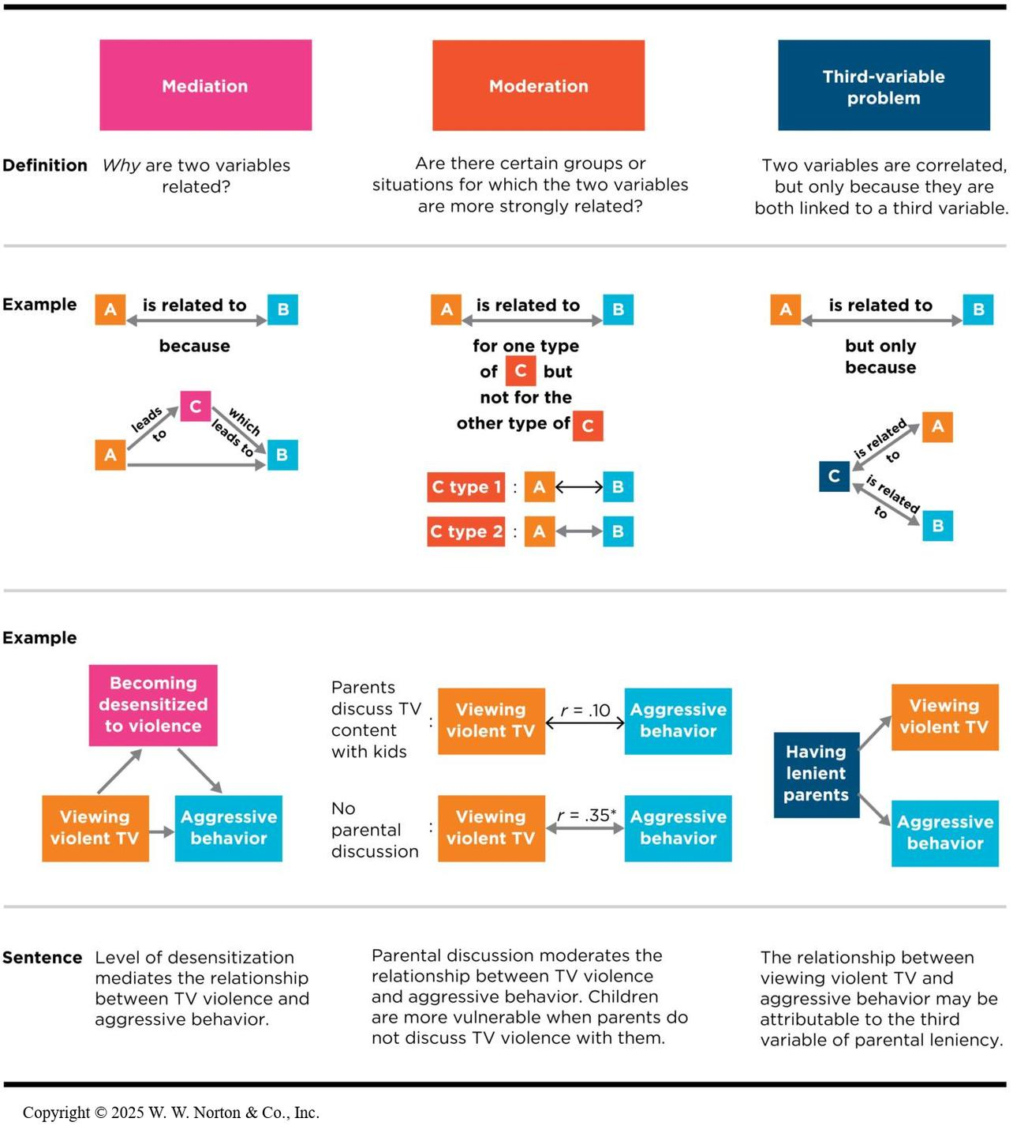
Mediators versus Moderators (2 of 2)
Notes:
Figure 9.14: Mediation, Moderation, and Third Variables
How are they different? (*p < .05)
Copyright © 2025 W. W. Norton & Co., Inc.

Slide 33
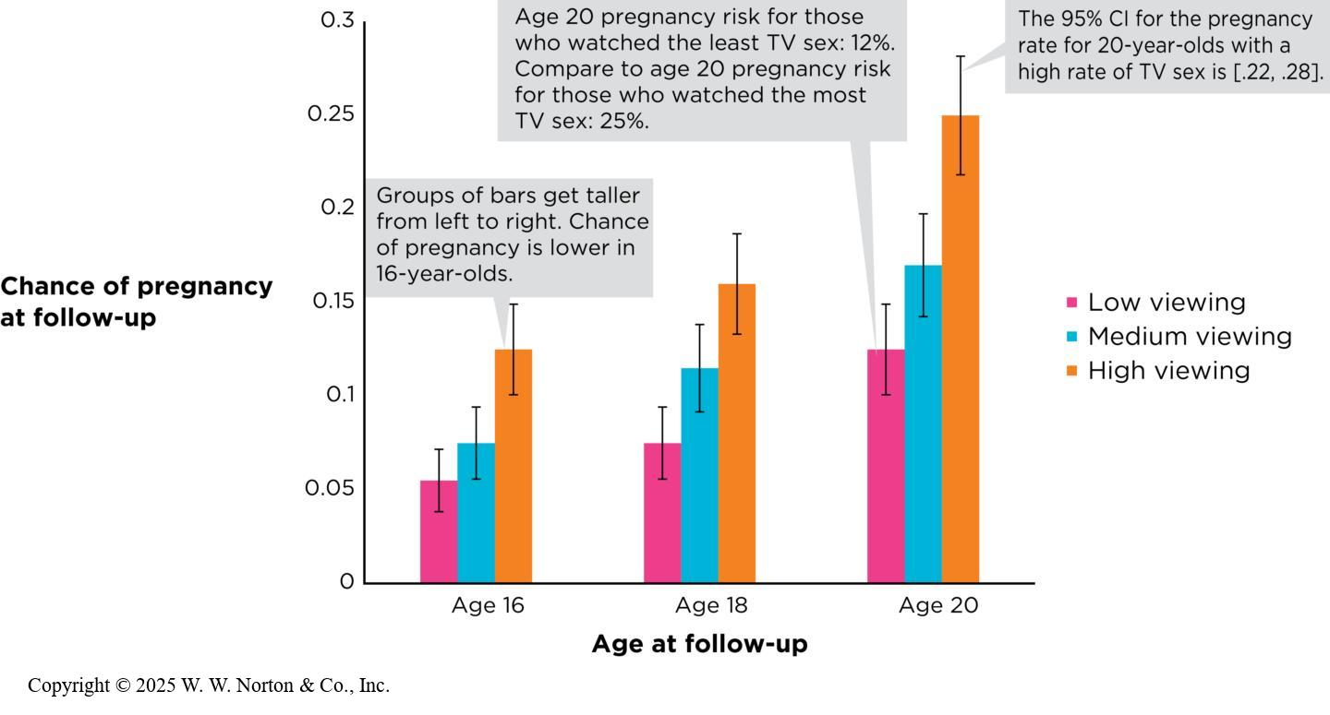
Multivariate Designs and the Four Validities
Internal validity (already discussed)
Construct validity
External validity
Statistical validity
Notes:
Figure 9.15: Effect Size and Precision in the Sexual TV Content and Pregnancy Study
The researchers calculated the pregnancy risk among teens who reported watching the lowest levels of sexual content (low viewing), as well as medium and high viewing levels. Different age groups were calculated separately. The graph depicts a large effect size for sexual content because the pregnancy risk for the highest viewers is double that for the lowest viewers. The error bars indicate the 95% CI for each estimate. (Source: Adapted from Chandra et al., 2008.)
We have already talked about how conducting multivariate correlational research (e.g., longitudinal designs, multiple regression) gets us closer to making causal claims. To review, longitudinal studies help with temporal precedence, and multiple regression helps rule out third variables. Thus, they help with internal validity.
Construct validity: It is important to interrogate the construct validities in all your variables in multivariate designs. Are your measures reliable and valid?
External validity: In order to interrogate the external validity of multivariate designs, you need to consider whether the results are generalizable to other people, contexts, situations, and so forth. You would want to look at how the sample was obtained. Was it a random sample?
Statistical validity: To interrogate statistical validity in multivariate designs, we need to consider the effect size of the beta and the statistical significance (p value). You might have several betas that are statistically significant, but you can compare their effect sizes within the same beta table.
In the case of the sex on TV and pregnancy study, we know the beta was 0.44 and was statistically significant. However, there are no guidelines for what constitutes a “large” or “small” beta. The authors of the study also presented the pregnancy risk of low, compared to medium and high, viewers of sexual content.
Copyright © 2025 W. W. Norton & Co., Inc.

